Slide 1
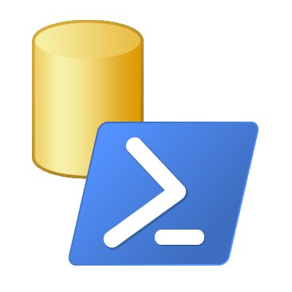
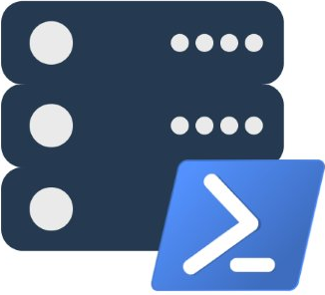
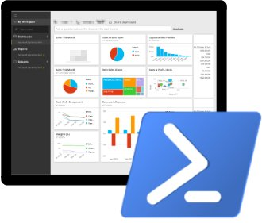
SQL Server and PowerShell - Better Together Building the Modern DBA’s Toolset
Presented by
Chrissy LeMaire and Rob Sewell

Slide 2
Slides and Code
Slides
Code
sqlps.io/preconslides
sqlps.io/preconcode

Slide 3



Who are we?
(Not a couple - we have our own wives.)
Chrissy – The one with the hair! @cl
Rob – The one with the beard! @sqldbawithbeard
PowerShell MVP, DBA at NATO Special Ops
Interests : PowerShell, SQL Server, cats, beer
Websites : netnerds.net, realcajunrecipes.com
Interesting Fact : Parents are native French speakers
Speaker : SQL Saturdays, PowerShell Conference EU, SQL Days Belgium, PowerShell & SQL Server User Groups
Community : Belgian PowerShell User Group, PASS PowerShell Virtual Chapter, SQL Community Collaborative
Lead for dbatools, major contributor to dbareports
DBA, Automator, Do-er, Trainer
Interests : PowerShell, Automation And SQL (PaaS geddit?)
Website : sqldbawithAbeard.com
Interesting Fact : (Still) Plays Cricket, Drone Flyer
Speaker : SQL Saturdays, SQL Relay, PowerShell Conference EU
Community : SQL South West , SQL Saturday Exeter , PowerShell Virtual Chapter Officer, Organiser for PowerShell Conference EU 2017, SQLBits Shouter!
Lead for dbareports, major contributor to dbatools

Slide 4
Who are you?
Tell us a little about yourself
What is your role? How big is your environment?
How long have you worked with SQL Server?
How long have you worked with PowerShell?
Why are you here?
What one thing do you want to know/understand by the end of the day?

Slide 5
Rules
Be good to each other ❤
Silence phones, but please but feel free to leave to answer calls
Ask a question whenever you want to, but note we may need to move on
Tweet, Facebook, and etc as much as possible!

Slide 6
Agenda
Introductions
SqlServer
Migrations
1
2
3
4
5
6
How to Start
Break!
Lunch!
9:00 | 9:15 | 10:00 | 11:00 | 11:20 | 12:15
Notes:
Introductions
Powershell with SQL - How to start
SQL Server Module
Break
dbatools – Migrations or other stuff ☺
LUNCH ☺
Pester testing
dbatools – best practices
Break
dbareports
Challenge – Questions – Discussions
Drinks (or whatever the organisers organise)

Slide 7
Agenda
Pester
Break!
Questions
7
8
9
10
11
12
Best Practices
dbareports
Drinks!
13:15 | 14:00 | 15:00 | 15:20 | 16:00 | #sqlfamily_at

Slide 8
Lets start with a demo you can follow along with The SQL Server PowerShell Provider
SQLSERVER:\>_
sqlps.io/preconcode

Slide 9
Brief History of SQL Server + PowerShell
SQLSERVER:\>_

Slide 10
First Release - SQL Server 2008
August 2008
Minishell - SQLPS.exe
Snapin - SqlServerProviderSnapin100
5 commands + Provider
Invoke-SqlCmd
Invoke-PolicyEvaluation
Convert-UrnToPath
Encode-SqlName
Decode-SqlName

Slide 11
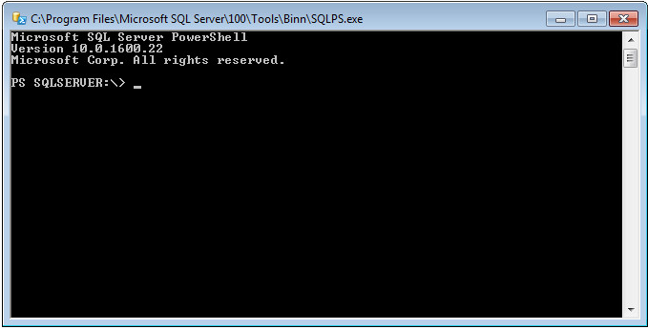
SQLPS.exe

Slide 12
Second Release - SQL Server 2012
April 2012
Module called SQLPS
33 total commands (28 new)
22 Availability Group commands
4 SQL Credential commands
2 Backup Restore Commands
New areas in the SQL Server Provider PS SQLSERVER:\> ———– SQL SQLPolicy SQLRegistration DataCollection XEvent Utility DAC IntegrationServices SQLAS
Notes:
44 Months

Slide 13
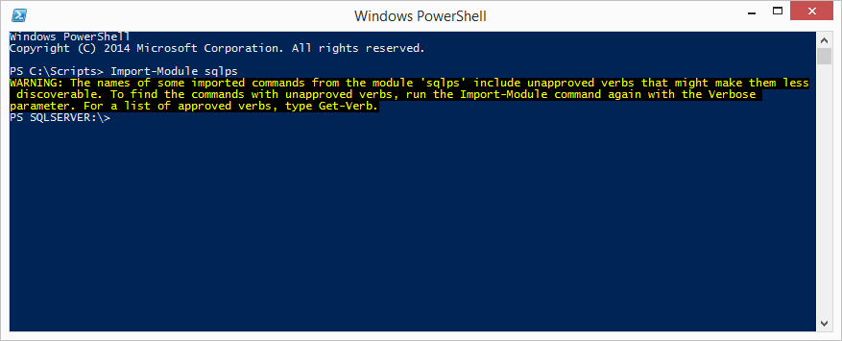
SQLPS Module

Slide 14
Third Release - SQL Server 2014
April 2014
45 total commands (12 new)
Firewall commands
4 Get commands (Database, Instance)
3 Set Commands
Start/Stop SQL instance
Notes:
6 years into it and we’ve only got 45 commands
Add-SqlFirewallRule
Get-SqlCredential
Get-SqlDatabase
Get-SqlInstance
Get-SqlSmartAdmin
Remove-SqlFirewallRule
Set-SqlAuthenticationMode
Set-SqlNetworkConfiguration
Set-SqlSmartAdmin
Start-SqlInstance
Stop-SqlInstance
Test-SqlSmartAdmin

Slide 15
SQLPS Module

Slide 16
Issues persisted
Tab-completion didn’t work
Invoke-SqlCmd was buggy
-WhatIf actually performed commands
SQLPS was slow to load
SQLPS changed the directory unexpectedly
SQLPS used unapproved verbs
Other platforms offered 700+ cmdlets
Notes:
We were still stuck at 45

Slide 17







The SQL Community wasn’t happy with the module
Notes:
Responses ranged from sad to resigned to pissed.
Felt Microsoft was unresponsive. Commands were random and few. No basic commands. Bugs were never/rarely fixed.

Slide 18




Community Response
PowerSSAS - 2007
SQLPSX - 2008
Get-SqlServer
Get-SqlDatabase
Get-SqlLogin
Get-SqlServerRole
75+ additional commands
SSRS PowerShell Provider - 2009
SPADE - 2011
Automated Installation Engine
dbatools - 2014
Migrations & Best Practices
dbareports - 2016
Reporting
Notes:
But these were still just filling in some of the gaps that were left by Microsoft that dbas and dbas and developers needed

Slide 19



2016 has been an amazing year!
Notes:
2016 changed everything

Slide 20
Everything’s changed
The SQL Server team hired a dedicated PowerShell engineer
Microsoft began taking Connect Items (suggestions + bug reports) seriously
SQLPS was renamed to SqlServer
Made it easier to do REGULAR RELEASES!
Initially these were monthly releases
But then they were doing two a month of SSMS
Working to separate from SSMS and go straight to the PowerShell Gallery

Slide 21
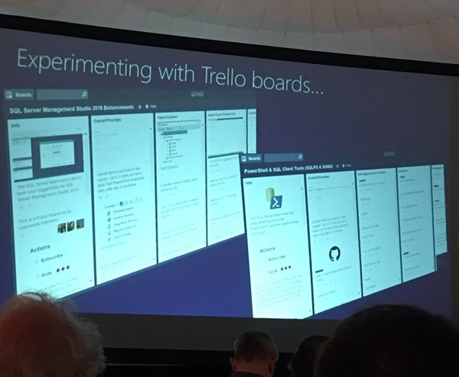
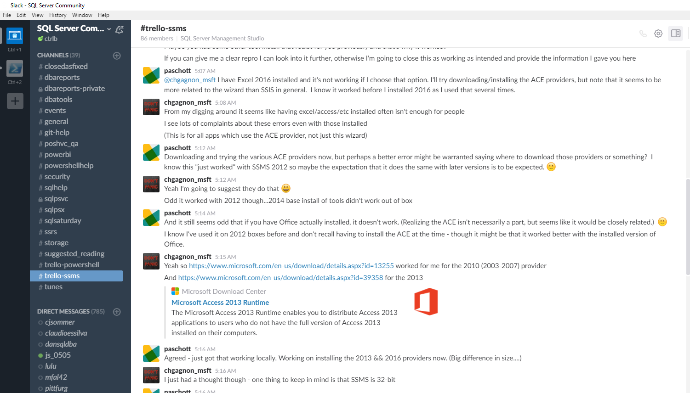
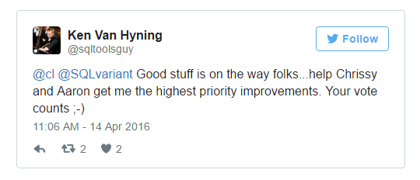
SQL Client Tools Renaissance
The SQL Server team began directly interacting with the community
SQL Community Trello boards - sqlps.io/vote & sqlps.io/ssms
SQL Community Slack - sqlps.io/slack
Twitter
The highest voted commands were created! Most talked about issues, fixed.
Notes:
Now the SQL team actually leads in community interaction, and other platform communities are asking their own Microsoft product group to use the SQL Server team’s approach as a model

Slide 22

SQL Client Tools Renaissance
“A few years back the SQL organization needed many of the engineers in the team to go help on Azure SQL Database. This included many of us from the tools team which had obvious impact on our ability to do anything significant in the SQL Client Tools space as a whole. We have been reinvesting in the tools again and I get a chance to be a part of leading our SQL Client Tools Renaissance we have begun.”
Ken Van Hyning, Engineering Manager for SQL Server Client Tools and All-Around Hero
Notes:
Microsoft also became more open in communicating the issues
Ken explained that engineers were poached, and the SQL Tools were neglected

Slide 23
30+ New Cmdlets + Fixes + New Name
New Name!
Import-Module SqlServer
Error Log
Get-SqlErrorLog
Set-SqlErrorLog
Always Encrypted
Add-SqlAzureAuthenticationContext
Add-SqlColumnEncryptionKeyValue
Complete-SqlColumnMasterKeyRotation
Get-SqlColumnEncryptionKey
Get-SqlColumnMasterKey
Invoke-SqlColumnMasterKeyRotation
New-SqlAzureKeyVaultColumnMasterKeySettings
New-SqlCngColumnMasterKeySettings
New-SqlColumnEncryptionKey
New-SqlColumnEncryptionKeyEncryptedValue
New-SqlColumnEncryptionSettings
New-SqlColumnMasterKey
New-SqlCspColumnMasterKeySettings
Remove-SqlColumnEncryptionKey
Remove-SqlColumnEncryptionKeyValue
Remove-SqlColumnMasterKey
Set-SqlColumnEncryption
Provider
WhatIf and Confirm now fully supported
SQL Server Agent
Get-SqlAgent
Get-SqlAgentJob
Get-SqlAgentJobHistory
Get-SqlAgentJobSchedule
Get-SqlAgentJobStep
Get-SqlAgentSchedule
Logins
Add-SqlLogin
Get-SqlLogin
Remove-SqlLogin
Invoke-Sqlcmd
-ConnectionString Parameter
-OutputAs (As) Parameter
Data
Read-SqlTableData Read-SqlViewData
Write-SqlTableData
Notes:
Company directive on the right
We have a total of 79 cmdlets, up from 45, and more being released regularly

Slide 24

SHOW US
SOME CODE,
BEARDY

Slide 25

Questions?
Notes:
http://www.menshairforum.com/talk/Thread-Beard-Facts-and-Beards-Meme-Facial-Hair-Manly-Knowledge

Slide 26
Simplifying SQL Server Migrations
dbatools

Slide 27
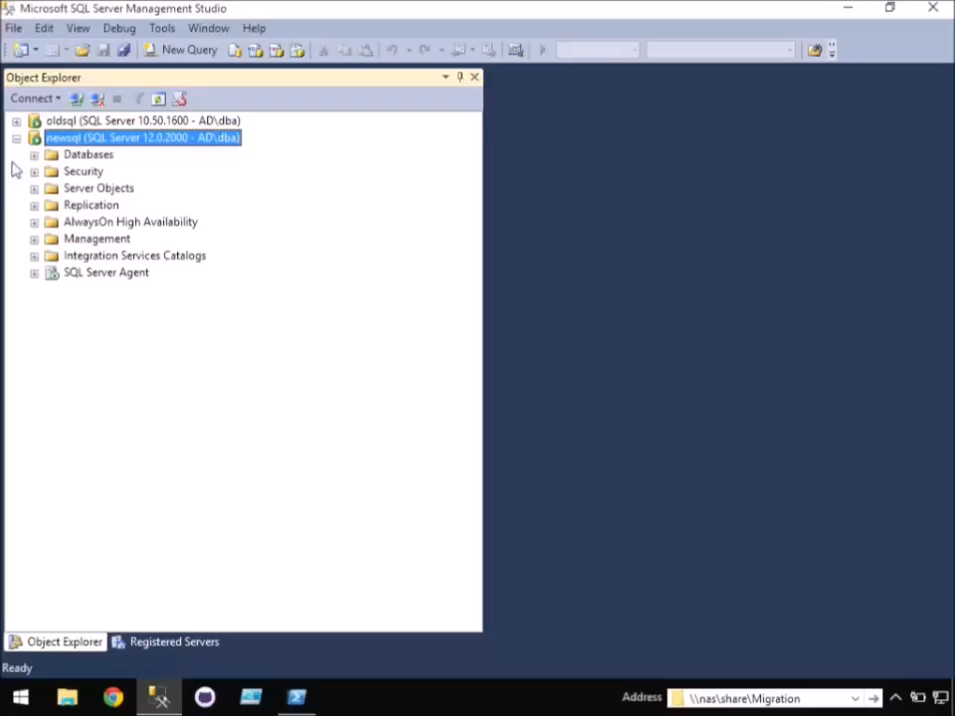
-WhatIf SQL Server migrations went more like this…

Slide 28
Agenda
Why
Considerations
Demos
1
2
3
4
5
What
How
Notes:
Won’t go into code much. Using PowerShell to simplify your migrations only requires you to know how to execute a cmdlet.

Slide 29





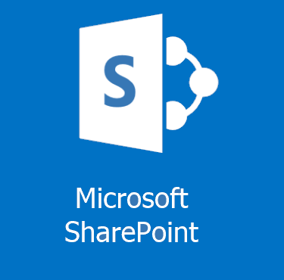
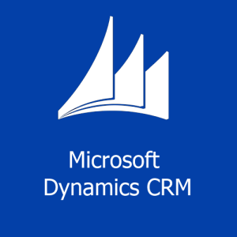
Why Migrate?
Misconfigured SQL Servers
Change in HA Strategy
Consolidation
Resource Requirements /
Best Practices
Platform Changes
SQL Server, OS, hardware, virtualization, Azure
Notes:
Misconfigured SQL Servers: In environments without dedicated database administrators, SQL Server is often installed by general technicians who do not optimize the system to deliver peak SQL Server performance. Organizations may also need to move to a different server collation.
Consolidation: uncontrolled server sprawl, cost savings
Change in HA Strategy: Organizations may decide on a new High Availability strategy, such as going from a failover cluster instance to AlwaysOn. Or they may migrate from a clustered instance, to a stand-alone instance, and handle their HA outside of Windows and SQL Server.
Resource Requirements/Best Practices: As an organization’s data requirements grow, SQL Server may outgrow the server on which it was originally built. This has a greater impact on non-virtualized environments, but virtualized servers may also be impacted by resource requirements when one server runs multiple instances of SQL Server, and one instance must be moved to a new server.
SQL Server/OS Upgrade: In-place upgrades are possible for both SQL Server and Windows, but are not ideal for every environment. Physical -> Virtual, or to the cloud, or even dev/test/staging.

Slide 30
What to migrate?
Databases
Logins
Jobs & Schedules
Server Configurations
Linked Servers
Credentials
Reporting Services
Integration Services
Maintenance objects
Availability Groups
Replication Settings
Central Management Server
Operators
Alerts
Proxies
Certificates
Policy Management
Resource Pools
..not an exhaustive list
Notes:
There’s a lot to migrate. Pretty much everything you see in SQL Server Management Studio can and perhaps should be migrated.
Server Configs include things like like backup compression defaults, enabling the CLR, etc.
Maintenance objects include things like Ola Hallengren’s backup scripts in the msdb database.

Slide 31
Considerations
there are a few...
Databases
Logins
Complex file structures, filestreams, full-text indexes, edition differences, version compatibility settings, server collation, mirroring, broker-enabled, trustworthy, read-only, owner Availability Groups, replication, associated logins, jobs, linked servers, post migration actions, reattach at source, set source read only, database state, log shipping, currently connected users, is system db, exists at destination,, owner chaining, associated logins, jobs, certificates, packages, etc.
SIDs, passwords, server roles,
server permission sets, credential mapping, password complexity & expiration, default db, owned databases, status, default language,
exists at destination, login type, destination login mode, version/hash compatibility, related objects like jobs, can’t drop if schema owner or assigned a permission set, does windows login exist at destination,
skip built in accounts, certificate mapped, asymmetric keys,
SQL Agent Objects
Linked Servers
related databases, logins, credentials, schedules, disabling on source
OLEDB provider & driver availability, local files, remote login passwords
Server Configs
(sp_configure)
Connstrings
Which applications & logins are connecting from which hosts?
Edition differences (Enterprise -> Std.) Version differences
..not an exhaustive list
Notes:
My point is, there’s a lot to think about. And this slide doesn’t even begin to cover it. This underlines why automation is so important. There’s less room for human error because the same checks are run each time, every time.
Databases
Complex file structures, filestreams, full-text indexes, edition differences, version compatibility settings, server collation, mirroring, broker-enabled, trustworthy, read-only, owner Availability Groups, replication, associated logins, jobs, certificates, packages, linked servers, post migration actions, reattach at source, set source read only, database state, log shipping, currently connected users, is system db, exists at destination, owner chaining, etc.
Logins
SIDs, passwords, server roles, server permission sets, credential mapping, password complexity & expiration, default db, owned databases, status, default language, exists at destination, login type, destination login mode, version/hash compatibility, related objects like jobs, can’t drop if schema owner or assigned a permission set, does windows login exist at destination, skip built in accounts, certificate mapped, asymmetric keys, and so on.
SQL Agent Jobs
related databases, logins, credentials, schedules, disabling on source
Linked Servers
OLEDB provider & driver availability, local files, remote login passwords
Server Configs (sp_config)
Edition differences (Enterprise -> Std.) Version differences
Connstrings
Which applications & logins are connecting from which hosts?
Fun lists
http://www.karaszi.com/sqlserver/info_moving_database.asp
http://yrushka.com/index.php/sql-server/database-recovery/sql-server-migration-from-one-server-to-another-detailed-checklist/
http://www.littlekendra.com/2016/01/12/whitepapers-for-planning-sql-server-migrations/
http://passmedia.sqlpass.org/media/24hours/2012_fall/PDF/02.pdf
Webcast
Kendra Little’s migration video
https://www.veeam.com/videos/sql-server-2005-migration-checklist-7008.html

Slide 32
Database migration methods
Backup and restore - well-suited for many situations - solid and straightforward - labor intensive, but scriptable
Detach, copy, attach - solid, but labor intensive - drops some attributes - increased downtime
Import Export Data Wizard - slow - can be messy & error prone - loses attributes and logins
Log Shipping - ideal for large databases - solid, but more complex - edition/version combo issues
Mirroring - ideal for large databases - complex - edition dependent
Copy Database Wizard - decent for small migrations - prone to errors - drops some attributes - dependencies often error out
Notes:
Backup / Restore
maintains most of the database attributes, except for db owner
Ideal for going between different editions like Express and Enterprise, and also different SQL Server versions.
When compression is enabled, it can actually be one of the faster ways to migrate a database.
Detach / Attach
Time consuming - it copies over white space unlike backup and restore, and you might have to traverse through deep directory structures when you're copying over data and log files.
Import / Export Wizard * SMO / not same database in the end
Has been described as "torturous" to use. I've actually never even used this in production, so I'll just skip this one.
Log shipping (initially uses backup/restore)
Cutover time is drastically reduced, especially when you compare it to the two previous methods. However, it is a little more complex, and it may not be supported by all SQL Server Edition and Version combinations. Nowadays, most often used temporarily, especially for migrations.
Classic Mirroring and AlwaysOn Advanced Mirroring (initially uses backup/restore)
Edition dependent, so you can't go from Standard to Enterprise. Also, Classic Mirroring was actually deprecated in SQL Server 2012. It is not version dependent though. So you can use this method to migrate between different versions of SQL Server.
Copy Database Wizard Export Import/Export / Detach Attach
The copy database wizard supports detach/attach /and/ SMO which is basically an import/export.
It provides a nice wizard interface, but is still pretty manual, especially when you're migrating multiple databases with complex file structures.
3rd Party Tools & SQL Server Replication
As far as 3rd party tools go, there are some have been recommended for database migration, but I always try to use natively available options, because these tools might not be available at every place I work, and procurement usually takes a while.
You can also check out Robert David’s Migration by Replication resources
http://www.sqlsoldier.com/wp/logshippingtricksdemo
http://sqlmag.com/database-high-availability/3-log-shipping-techniques
Mirroring vs Log Shipping
With Log Shipping:
Data Transfer: T-Logs are backed up and transferred to secondary server Transactional Consistency: All committed and un-committed are transferred Server Limitation: Can be applied to multiple stand-by servers Failover: Manual Failover Duration: Can take more than 30 mins Role Change: Role change is manual Client Re-direction: Manual changes required
With Database Mirroring:
Data Transfer: Individual T-Log records are transferred using TCP endpoints Transactional Consistency: Only committed transactions are transferred Server Limitation: Can be applied to only one mirror server Failover: Automatic Failover Duration: Failover is fast, sometimes < 3 seconds but not more than 10 seconds Role Change: Role change is fully automatic Client Re-direction: Fully automatic as it uses .NET 2.0
Source http://bit.ly/1XEhFJJ

Slide 33
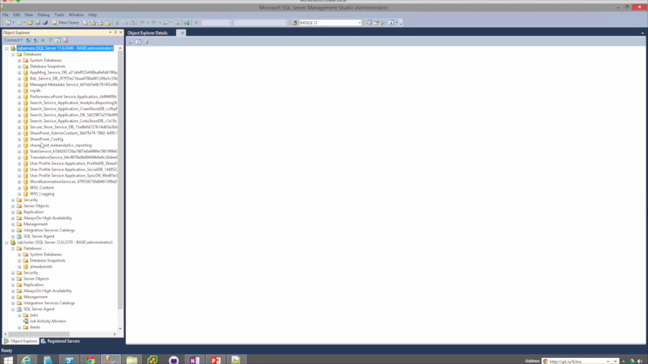
Copy Database Wizard / Detach Attach demo
Notes:
Even speeding up the video still takes awhile to migrate just a few small databases. The mistake I made while filming this was genuine, too.

Slide 34
Login migration methods
SSIS Transfer Logins Task
Very painful
changes passwords
disables account
does not transfer server roles or server permission sets
maintains SIDs
sp_help_revlogin Less painful, but still..
maintains passwords & SIDs
doesn’t disable account
does not transfer server roles or server permission sets
still manual / doesn’t scale well
Notes:
Microsoft provided the Transfer Logins Task within SSIS, which is based on SMO This method is extremely painful. It changes the passwords, disables the account, and doesn't transfer server roles of server permission sets. But! It does maintain the login SID.
Then there's sp_help_revlogin which you're probably familiar with
I once considered this stored procedure from Microsoft a god-send because it maintains the SIDS, migrates the password, and doesn't disable the account, however it also doesn't transfer server roles or server permission sets, and in my experience, most DBA's actually use this script as a starting point, and then build additional functionality on top of it.
Even then, it's still a manual process that doesn't scale well, especially when you are migrating logins for several servers, or want to migrate the logins on an ongoing basis.

Slide 35
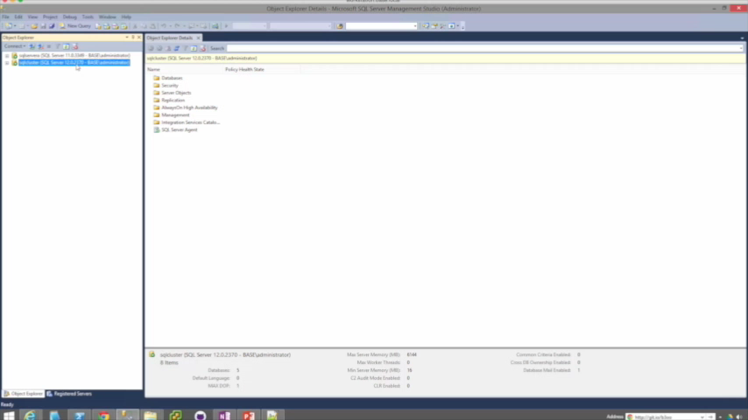
Login migrating using sp_help_revlogin
Notes:
This one is not sped up, so that you can be tortured along with me.
It’ll often bomb out. Doesn’t copy roles or server permission sets.

Slide 36
Migrating other stuff
Job Server Objects
AlwaysOn
SSIS Transfer Logins Task
Very painful
changes passwords
disables account
does not transfer server roles or server permission sets
maintains SIDs
sp_help_revlogin Less painful, but still..
maintains passwords
maintains SIDs
does not transfer server roles or server permission sets
still manual / doesn’t scale well
SSMS / SMO / SSIS Transfer Job Task / restore msdb
Highly scriptable within SSMS & SMO
Server Configs
Database Mail
Use some T-SQL or SMO to craft some
T-SQL to execute some T-SQL
SMO, T-SQL, may include credentials
Linked Servers
Credentials
No way provided by Microsoft that includes passwords
No way provided by Microsoft that includes passwords
Finding SQL Server Keys
Central Management Server
Dig through the registry
Import/Export but sometimes errors on import
Notes:
There’s so much more, but here’s a start.
First, for the job sever otherwise known as SQL Server Agent, you can perform a migration in a variety of ways, up to and including restoring the msdb database, although that does introduce a few complexities, so I tend to migrate using scripts.
With AlwaysOn, this is also highly scriptable using SSMS and SMO.
sp_configure. now I've seen a few ways to do this, but mostly you use some T-SQL or SMO, to craft some T-SQL to execute on another SQL Server.
Central Management Server, does have built in import/export functionality, but you may encounter a terminating error on import when the destination CMS server name is contained within the XML import file.
Linked Servers, are challenging to migrate because of the way that the passwords are stored, that is, not within the database engine, but rather, encrypted deep within the registry. Same goes for Credentials.
Now when it comes to Finding your SQL Server key, this isn't too hard, there are scripts available online that will do it for you, but it does require digging through the registry if you're doing it manually. SQL keys ae useful for upgrading/downgrading editions.
And finally, database mail can be migrated using SMO, or T-SQL, but keep in mind that it may contain credentials, which brings us back to the challenge of decrypting these passwords in order to migrate the associated credential.

Slide 37
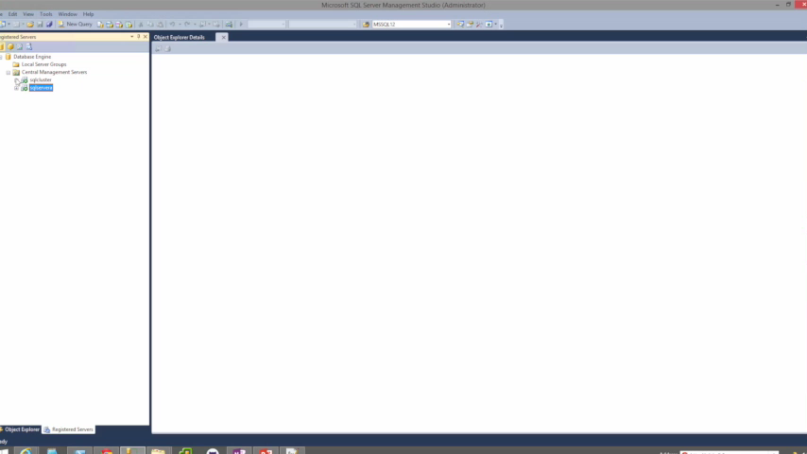
How CMS Import/Export usually goes for me.
Notes:
There are very few situations where this doesn’t error out. I usually have to edit the XML to remove the duplicate server.

Slide 38

PowerShell, the better way.
Migration Commands
Copy-SqlLogin
Copy-SqlDatabase
Copy-SqlServerAgent
Copy-SqlSpConfigure
Copy-SqlDatabaseMail
Copy-SqlBackupDevice
Copy-SqlServerTrigger
Copy-SqlLinkedServer
Copy-SqlCredential
Copy-SqlSysDBUserObjects
Copy-SqlCentralManagementServer
Copy-SqlAudit
Copy-SqlAuditSpecification
Copy-SqlAgentCategory
Copy-SqlAlert
Copy-SqlCustomError
Copy-SqlDataCollector
Copy-SqlEndpoint
Copy-SqlExtendedEvent
Copy-SqlOperator
Copy-SqlPolicyManagement
Copy-SqlProxyAccount
Copy-SqlResourceGovernor
Copy-SqlServerTrigger
Copy-SqlSharedSchedule
Copy-SqlSsisCatalog
Start-SqlMigration
Remember: Get-Help
Notes:
Used to dread but now it’s fun
When I was preparing for my own migration at work, I thought there has to be a better way to do all of this. Initially, I was automating sp_help_revlogin and then I thought I should go to pure PowerShell, and that’s really where this all got started.
In the end, I compiled a number of scripts into a PowerShell module that I call dbatools that has a number of commands DBA’s are going to love.
When building these commands, I always try to support SQL Server 2000-2016, clusters, named instances, and all editions from Express to Enterprise. Most do require sysadmin access and will error out. If you have any questions, I do try my best to properly document each command.
Copy-SqlLogin
This command supports all editions of SQL Server 2000-2016, and it migrates both SQL Logins and Windows logins.
It can add, overwrite when force is specified, or sync. The sync switch syncs permissions, but does not add accounts.
If you do use force, force will drop and recreate the specified logins, except for the one executing the script, and the SQL Service account login.
By default, all logins are migrated. The include switch will only migrate the specified logins. It's also automatically populated by the logins on the source server for tab completion. Exclude logins will migrate ALL logins except for those specified.
Copy-SqlDatabase
Migrates in two ways: backup/restore and detach/attach
It does not migrate system databases. Migrates including all file groups, filestreams and full-text indexes.
Supports NoRecovery!
Copy-SqlJobServer and Copy-SqlDatabaseMail are very basic, they just copy everything.
Copy-SqlLinkedServer and Copy-SqlCredential are also similar. You can specify which linked servers and credentials you want. Requires remote registry on.
Copy-SqlCentralManagementServer, copies all groups & subgroups.
Export-SqlSpConfigure to path. Import-SqlSpConfigure from file or from server.
Start-SqlMigration combines all of this!!! And transcribes!

Slide 39
Demo time!

Slide 40
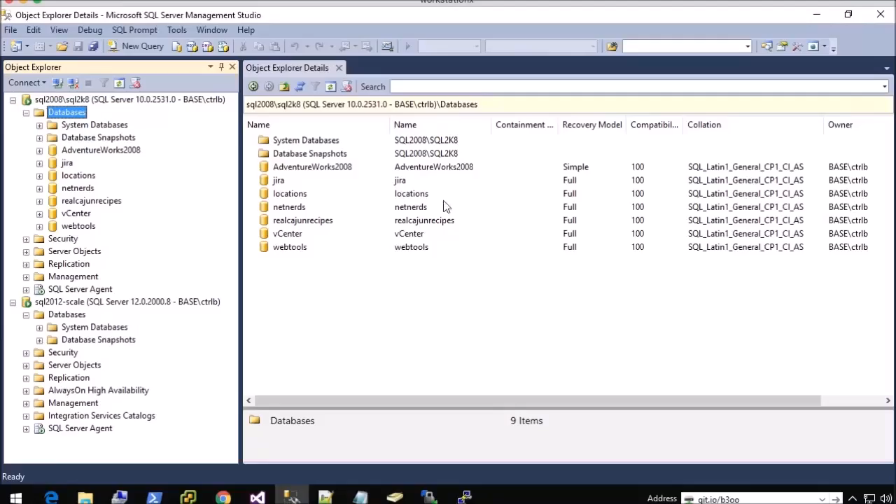
Bonus Video! Fun with Out-Grid

Slide 41
Review
PowerShell <3 SQL Server <3 PowerShell
Simplifies, and also prevents human error
No more checklists or boredom
Be a hero and impress your friends
Find it at dbatools.io
Notes:
Copy-SqlDatabase
SQL Server 2000-2014, clusters, named instances, all editions
DB – Backup/Restore & Detach/Attach
User objects in system databases (such as Hallengren’s scripts)
Complex file structures, FILESTREAM, file groups, full-text indexes
Move one, many or all databases
Command-line auto completion of databases
Automatically determines default data and log directories
Supports reusing exact folder structures
Copy-SqlLogin
SQL Server 2000-2014, clusters, named instances, all editions
Windows & SQL Authentication
SIDs, passwords, permission sets, roles, default db
SyncOnly option syncs permissions
Include or exclude any specific login (auto-completed)
Does not currently support certificate mapped or asymmetric keys
Does not migrate credentials. Use Copy-SQLCredential
Start-SqlMigration
Shortcut command to migrate entire instance, including databases, logins, credentials, linked servers, db mail, etc.
Copy-SqlCredential
Migrates passwords
Requires remote registry access
Copy-SqlLinkedServer
Migrates passwords
Migrates only if provider exists on destination server
Does not migrate ODBC connections (yet) or drivers
Does not copy over local files, such as SQLite databases
Requires remote registry access
Copy-SqlCentralManagementServer
Copies Registered Servers from CMS to CMS
Migrate one, multiple or all server groups
Get-SqlServerKey
SQL Server 2005-2014, clusters, named instances, all editions
Server list: command line, file, or Central Management Server
Finds keys for all instances on a server
Requires remote registry access for remote servers
Watch-SqlDbLogin
Helps find connstrings that need to be updated
Does not require SQL Server Auditing, but can be less accurate
Restore-HallengrenBackups
Restores Backups generated Ola Hallengren’s DBA scripts
Only supports default backup structure at this time
Can reuse advanced file structures found within backup file
How to move databases between computers that are running SQL Server: http://support.microsoft.com/kb/314546
Minimizing DB Migration Downtime Using Log Shipping: http://blogs.msdn.com/b/sqlgardner/archive/2011/09/16/minimizing-db-migration-downtime-using-log-shipping.aspx
Migrating a VLDB in SQL Server with Log Shipping: http://www.mssqltips.com/sqlservertip/2073/migrating-a-vldb-in-sql-server-with-log-shipping/
SQL Server Database Migration Checklist: http://www.mssqltips.com/sqlservertip/1936/sql-server-database-migration-checklist/
Understanding the value of Enterprise Edition, one feature at a time: http://blogs.msdn.com/b/ialonso/archive/2011/09/21/understanding-the-value-of-the-enterprise-edition-one-feature-at-a-time.aspx
Using Mirroring to Reduce DB Migration Downtime: http://blogs.lessthandot.com/index.php/datamgmt/dbprogramming/move-databases-to-new-server-with-little-1/
Prerequisites, Restrictions, and Recommendations for Database Mirroring: https://msdn.microsoft.com/en-us/library/ms366349.aspx?f=255
What is the relationship between logins, credentials, and proxies? And why they were introduced? http://www.jasonstrate.com/2013/07/security-questions-logins-credentials-and-proxies
How to migrate SQL Server 2008 to a new server: http://www.bidn.com/blogs/MMilligan/bidn-blog/3207/how-to-migrate-an-instance-of-sql-server-2008-to-a-new-server
Ola Hallengren’s SQL Server Maintenance Scripts: https://ola.hallengren.com/
Migrating a SQL Server instance: http://www.mssqltips.com/sqlservertip/1246/migrating-a-sql-server-instance/
Registered Servers and CMS: https://www.simple-talk.com/sql/sql-tools/registered-servers-and--central-management-server-stores/
Never ever set up a Database Mirroring session across different SQL Server Editions (SKU): http://blogs.msdn.com/b/ialonso/archive/2011/11/09/never-ever-set-up-a-database-mirroring-session-across-different-sql-server-editions-sku.aspx

Slide 42



Lunch
Back At 1-15

Slide 43

Turning Your Checklists into Pester Tests
pester
[+] Green is Good 558ms [-] Red is Bad 168ms

Slide 44

Notes:
Checklists, we all have them and use them wether for installations, processes or even presentations!

Slide 45
What is Pester?
Pester provides a framework for running unit tests to execute and validate PowerShell commands from within PowerShell
github.com/pester/Pester
Notes:
Its used for unit testing or TDD but can also be used to validate an environment. Comes with Windows 10 or install from the gallery with Install-Module Pester

Slide 46
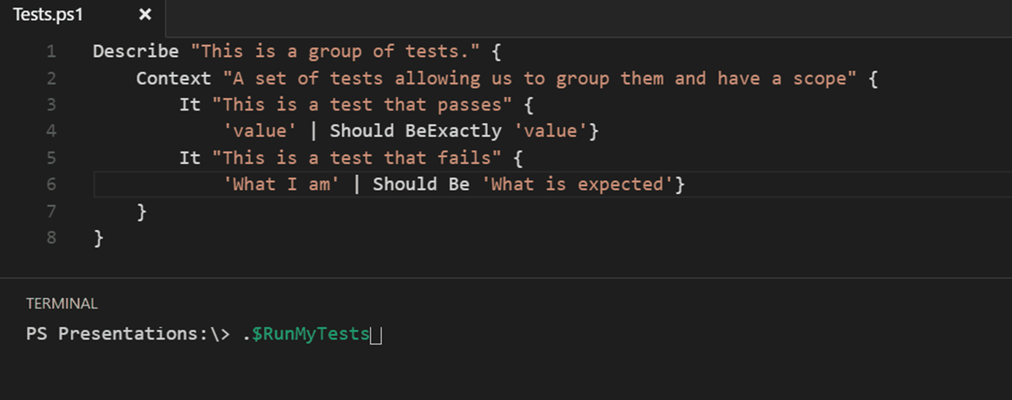
Notes:
This is a Pester test running in VS Code

Slide 47


I am so terribly sorry

Slide 48
Should Operators
Be Compares one object with another for equality. Case Insensitive
BeExactly Compares one object with another for equality . Case Sensitive
BeGreaterThan Asserts that a number is greater than an expected value.
BeLessThan Asserts that a number is less than an expected value.
BeLike Asserts that the actual value matches a wildcard pattern using -like operator. Case Insensitive
BeLikeExactly Asserts that the actual value matches a wildcard pattern using -like operator. Case Sensitive
BeOfType Asserts that the actual value should be an object of a specified type
Exist Does not perform any comparison but checks if the object calling Exist is present in a PS Provider.
Contain Checks to see if a file contains the specified text. Case Insensitive
ContainExactly Checks to see if a file contains the specified text. Case Sensitive
Match Uses a regular expression to compare two objects. Case Insensitive
MatchExactly Uses a regular expression to compare two objects. Case Sensitive
Throw Checks if an exception was thrown in the input ScriptBlock.
BeNullOrEmpty Checks values for null or empty (strings).
I hate slides with lots of text but I think this one is valid

Slide 49
What Can You Validate?

Slide 50
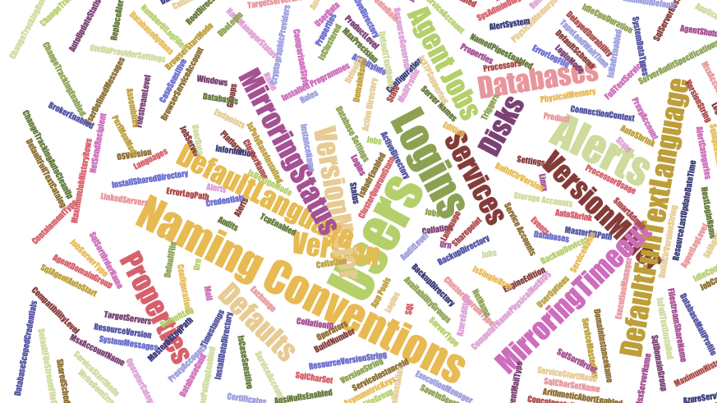
What Can You Validate?
Maybe not EVERY thing but anything that you can check with PowerShell
$srv|Get-Member -MemberType Property |Select-Object name
$srv|Get-Member -MemberType Property |Select-Object name
$srv.JobServer | Get-Member -MemberType Property |Select-Object name
$srv.Databases | Get-Member -MemberType Property |Select-Object name
$srv.Configuration | Get-Member -MemberType Property |Select-Object name

Slide 51
MUST BE TIME
FOR A DEMO

Slide 52
Review
We all have checklists – manual testing is error-prone
Pester is a Unit Testing Framework for PowerShell
You can use it to validate your infrastructure
The basic syntax uses Describe, Context and It Code blocks
The Should command is used for testing assertions
Use the NunitXML output and the reportviewer.exe to make HTML reports

Slide 53
SQL Server Administration and Best Practices
dbatools

Slide 54
PowerShell, SQL & PowerBI
Reducing a DBAs Context Switching
dbareports

Slide 55
What Problem are we Solving?

Slide 56
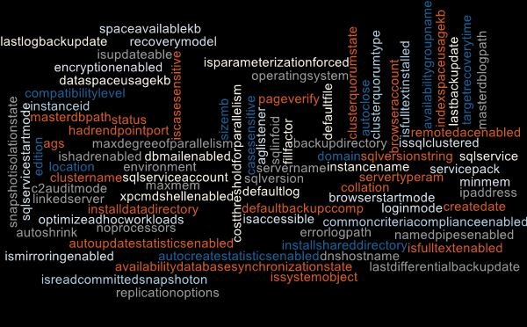
Questions
Managers
PMs
Developers
Compliance
Auditors
DBAs
Change Managers
How Many?
Where Are?
What Is?
Which?
When?
Notes:
Compliance want to know how many Server 2003 or SQL 2005 or XPCMDShellEnabled
Project Managers and the project team want to know which servers and databases for their systems, how big, what settings etc
Systems Team, Change Managers want to know which servers and which clients are in which Data Centre for maintenance work (UPS replacement for example)

Slide 57
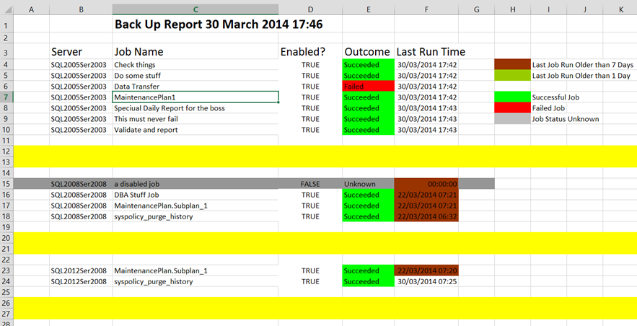
Replace The Old Ways
Notes:
It’s time to move on from the Old Ways of doing things.
I loved my Excel sheet with RAG for every agent job generated every day but in this modern world do we need to be emailing or saving files on shares to get our information

Slide 58
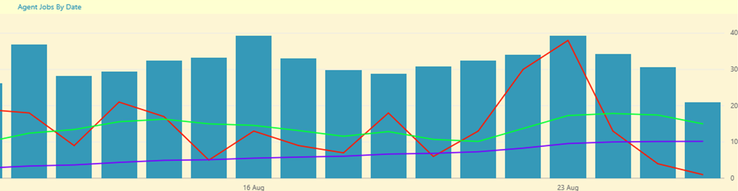
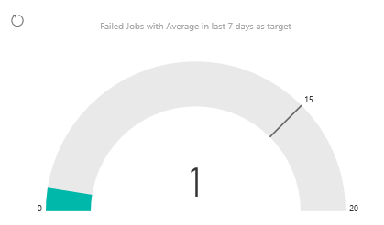
Instant Views For The DBA Team
Notes:
We – The DBA Team want good visualisations of exactly the information that we want to see including averages to see our improvement.
Here we see a rolling 30 day average for failed jobs (Blue) Rolling 7 day average (green) Failed Jobs (Red) and a gauge showing the failed jobs today against the average
But also we can show the number of SQL 2000 instances going down or other goals or objectives that we have a team have been set

Slide 59

Help Yourself
Notes:
Self-Service – Enable the Requestors to get what they want when they want
Reduce the load on the DBA Team

Slide 60
Voice Activated Baby :-)
Need to insert this here
https://youtu.be/da6S1j32_Ok?t=3m24s
https://dbareports.io/youtube has more videos.

Slide 61




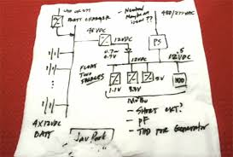
SOLUTION
REQUIREMENTS
Local Knowledge
Notes:
What do we need to build our solution to this problem?
Powershell – to gather our information
SQL Server – to store the information and ensure that it is kept available and backed up (and in control of the DBA Team
Power Bi – to create the reports and view/share them
Local Knowledge – Whether you keep your instances in a CMS or in a text file or on the back of a napkin you will need to know where they are

Slide 62
How To Do It
Install-DBAreports -SqlServer sql2016 -InstallPath \\fileshare\share\sql -Verbose
Add-DbrServerToInventory sql2016, sql2014 -Environment Production -Location Exeter
Notes:
:-)

Slide 63
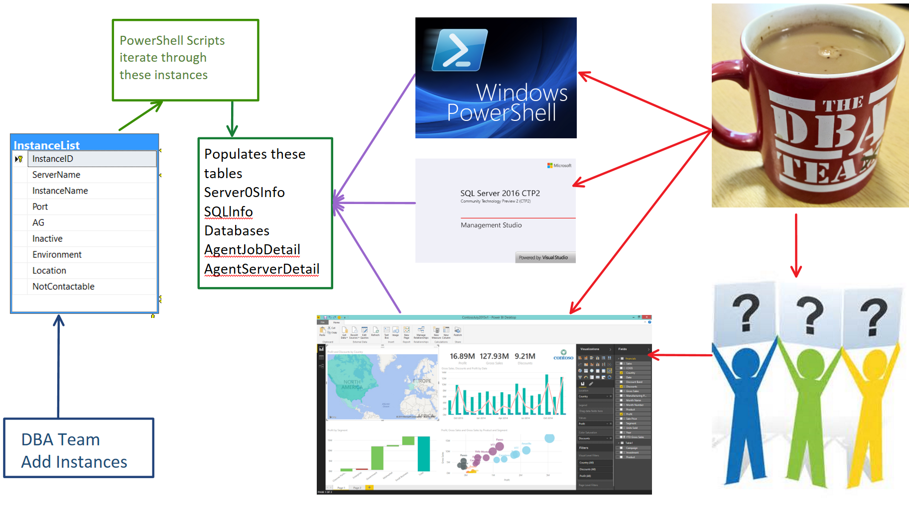
Notes:
DBA – Fills in instances
Agent Jobs run every night to gather the information regularly (Agent Job Databases, every night, Server, SQL every week
Now the DBA Team can use powershell to gather information – My Find-Database function queries this (and we use Excel too so the information is available locally in the case of disaster)
The DBA Team can use TSQL too. The information is pretty up to date and we have the date checked column to see when last checked
They can then answer questions quicker (No need to connect to a server)
They can quickly identify instances which need action (Policies not set (Max mem, Min mem Adhoc workload enabled etc)) and target them with powershell
BUT – Now we can let them ask their own questions ☺ and have access to the data they require when ever they want.

Slide 64
MUST BE TIME
FOR A DEMO

Slide 65

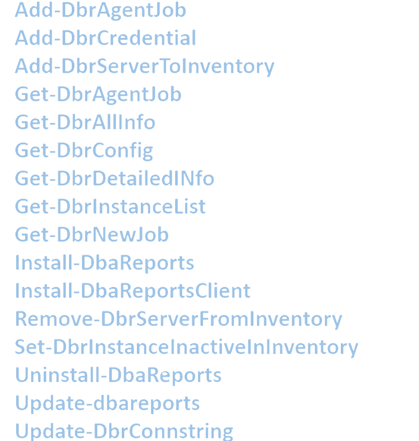




dbareports
dbareports – sibling of the truly amazing dbatools
Has an awesome team working on it already
Chrissy LeMaire,
Claudio Silva,
Jason Squires,
Andy Mallon
We would love your input and contribution
You can find out more at https://dbareports.io
There is a Trello Board at https://dbareports.io/trello
You can come and join in the Slack Channel #dbareports
It will be available on GitHub very soon
Follow @psdbareports on twitter

Slide 66

Questions

Slide 67
What More Would You Like to Know?
Ask Us Anything or Challenge Us
Questions
Challenges you face
Why doesn’t it do…… ?
I want to do …..
What's the best way to ……
Etc etc

Slide 68
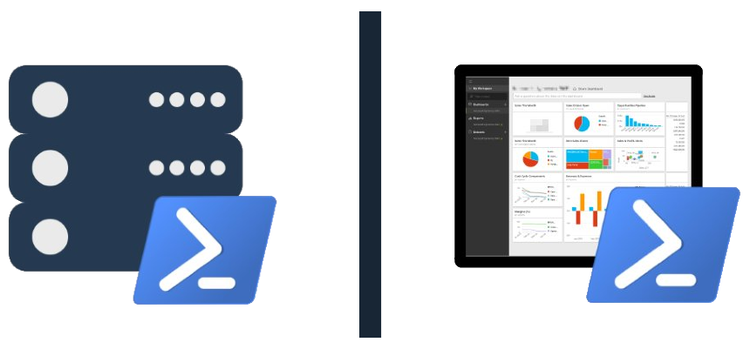
Community Has Taken up the Baton
SQL Server Community Collaborative github.com/sqlcollaborative

Slide 69


SQL PowerShell VC
Established 2010
28 presenters, 35 sessions
6,200+ members
Aaron Nelson
Lead
Chrissy LeMaire
Co-lead
Rob Sewell Officer
Martin Catherall
Officer
powershell.sqlpass.org | sqlps.io/vote | sqlps.io/youtube | sqlps.io/slack

Slide 70


Join our YouTube + SQL Community Slack
sqlps.io/youtube
sqlps.io/slack
powershell.sqlpass.org | sqlps.io/vote | sqlps.io/youtube | sqlps.io/slack

Slide 71

Microsoft wants to hear from you!
“I see these cmdlets on Trello, please upvote the ones you want to see us working on next!”
Vin Yu, Program Manager, Data Platform
“Good stuff is on the way folks...help Chrissy and Aaron get me the highest priority improvements. Your vote counts ;-)”
Ken Van Hyning, Engineering Manager for SQL Server Client Tools
“Meanwhile, the DBA/MVP community has created its own channels where SQL tools team members participate. The Trello board is building momentum, and there's a new Slack channel. More of us are trying to monitor forums like #sqlhelp, reddit and stackoverflow on a regular basis as well."
David Shiflet, Principal Software Engineering Manager, SQL Azure
“Trello is addicting!”
Our Busy Hero, SQL PowerShell Engineer, Matteo Taveggia
powershell.sqlpass.org | sqlps.io/vote | sqlps.io/youtube | sqlps.io/slack

Slide 72

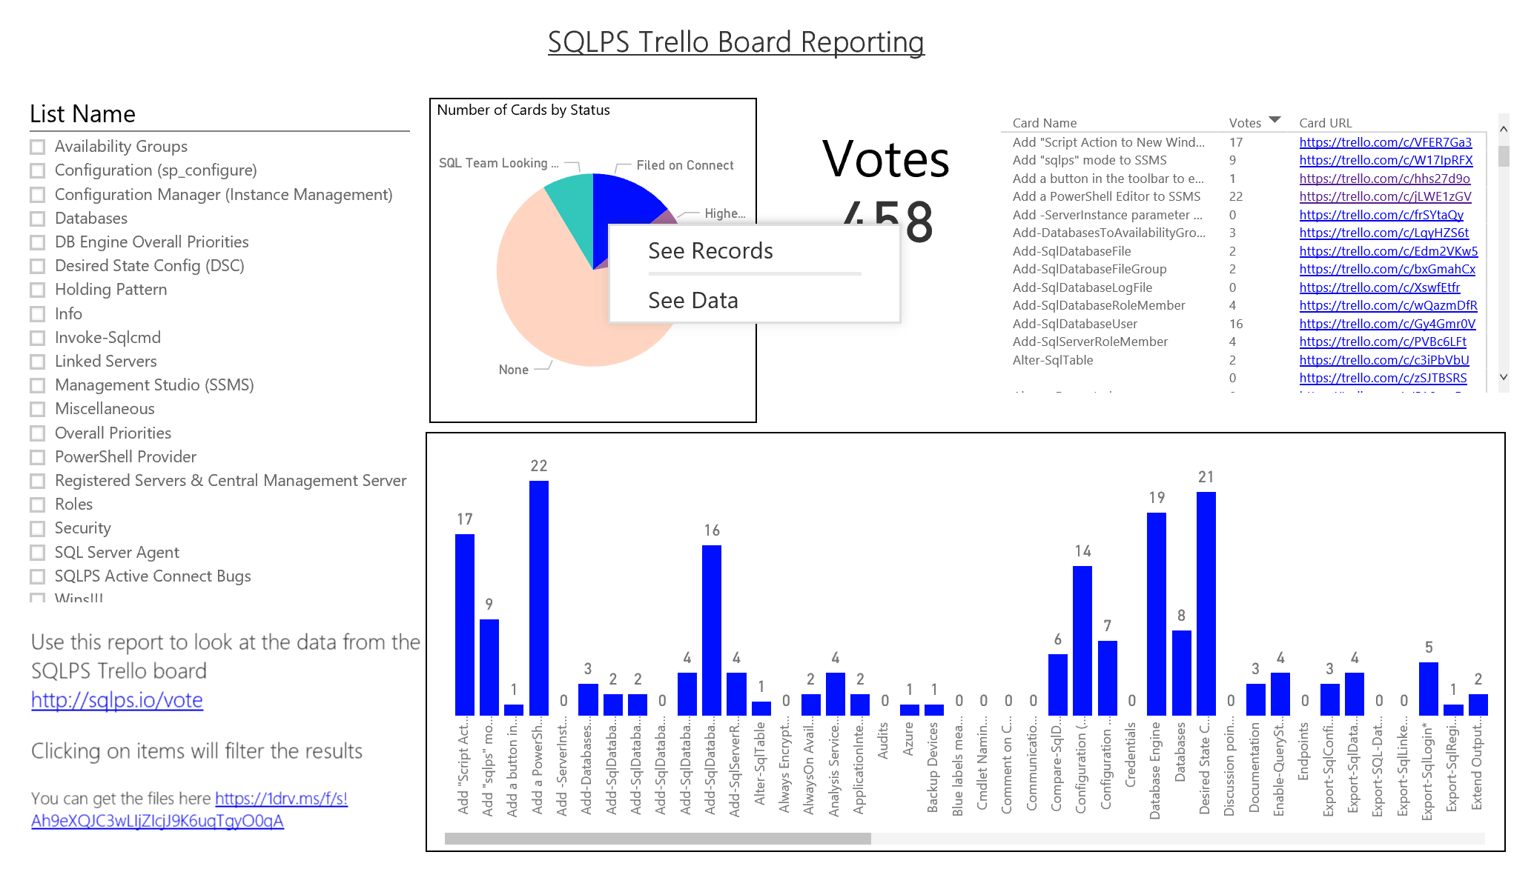
Influence Microsoft
sqlps.io/vote
sqlps.io/reports

Slide 73

Questions
powershell.sqlpass.org | sqlps.io/vote | sqlps.io/youtube | sqlps.io/slack

Slide 74
Contact Us
(Still not a couple.)
Chrissy – The one with the hair! @cl
Rob – The one with the beard! @sqldbawithbeard
netnerds.net
dbatools.io
@cl on twitter (what what!)
clemaire@gmail.com
ctrlb on Slack
sqldbawithabeard.com
dbareports.io
@sqldbwithbeard on twitter (what what!)
mrrobsewell@outlook.com
sqldbawithabeard on Slack

Slide 75
Thank you so much!
Cool Free Things
PASS PowerShell Virtual Chapter sqlps.io add /video for YouTube channel
SQL Community Slack sqlps.io/slack
dbatools – Amazing PowerShell module for DBAs dbatools.io
dbareports – SQL PowerShell SSRS PowerBi & Cortana dbareports.io
SQL Collaborative Git Hub Organisation github.com/sqlcollaborative
Influence Microsoft
sqlserver PowerShell module - sqlps.io/vote
SSMS sqlps.io/ssms
PowerShell PowerBi integration sqlps.io/powerbi

